Slide 1

HD MEETING PRESENTATION

Slide 2






HD MEETING PRESENTATION
Activities Calendar
Planned activities
Recent Minutes of Meeting
Outcome Planner Progress
Issues of discussion
February,2022
March,2022

Slide 3

HD MEETING PRESENTATION
Activities Calendar
Planned activities
Recent Minutes of Meeting
Outcome Planner Progress
Issues of discussion
February,2022
March,2022

Slide 4
Activities Calendar : February,2022 Activity Type
1
2
3
Regular
New Initiative
Additional

Slide 5


Activities Calendar : February,2022 Activity Type
1
Link
Activity Name
Completed ☑
Verification of Student Registration for session 21222 from Academic Dashboard and Database.
Status /Remarks
Regular
2
3
New Initiative
Additional

Slide 6
Activities Calendar : February,2022 Activity Type
1
Link
Activity Name
Completed ☑
Verification of Sectioning data of schools proposed by Academic Operations for session 21222.
Status /Remarks
Regular
2
3
New Initiative
Additional

Slide 7
Activities Calendar : February,2022 Activity Type
1
Link
Activity Name
Completed ☑
Verification of timetable punched by school AOCs for session 21222.
Status /Remarks
Regular
2
3
New Initiative
Additional

Slide 8
Activities Calendar : February,2022 Activity Type
1
Link
Activity Name
Completed ☑
Preparation and verification of Academic Load of faculty members for session 21222.
Status /Remarks
Regular
2
3
New Initiative
Additional

Slide 9
Activities Calendar : February,2022 Activity Type
1
Link
Activity Name
Ongoing ▶
Prepare the action plan on faculty members who have not scheduled Makeup classes for Not held classes.
Status /Remarks
Regular
2
3
New Initiative
Additional

Slide 10
Activities Calendar : February,2022 Activity Type
1
Link
Activity Name
Ongoing ▶
Planning for the Engineering Minor sessions for upcoming term 22231
Status /Remarks
Regular
2
3
New Initiative
Additional

Slide 11
Activities Calendar : February,2022 Activity Type
1
Link
Activity Name
Ongoing ▶
Plan an interaction session for school AOCs regarding Academic Operations Dashboard and Dynamic Reports along with Preparation of Presentation and pdf help files
Status /Remarks
Regular
2
3
New Initiative
Additional

Slide 12
Activities Calendar : February,2022 Activity Type
1
Link
Activity Name
Ongoing ▶
RMS handling regarding academic operations
Status /Remarks
Regular
2
3
New Initiative
Additional

Slide 13
Activities Calendar : February,2022 Activity Type
1
Link
Activity Name
Ongoing ▶
Backlog Registration for Spring Term
Status /Remarks
Regular
2
3
New Initiative
Additional

Slide 14
Activities Calendar : February,2022 Activity Type
1
Link
Activity Name
Ongoing ▶
Backlog Registration for Spring Term
Status /Remarks
Regular
2
3
New Initiative
Additional

Slide 15
Activities Calendar : February,2022 Activity Type
1
2
3
Regular
New Initiative
Additional

Slide 16
Activities Calendar : February,2022 Activity Type
2
New Initiative
1
3
Regular
Additional

Slide 17
Activities Calendar : February,2022 Activity Type
2
Link
Activity Name
Completed ☑
Verification of load relaxation of faculty members with the slot punching in timetable.
Status /Remarks
New Initiative
1
3
Regular
Additional

Slide 18
Activities Calendar : February,2022 Activity Type
2
Link
Activity Name
Ongoing ▶
Maintaining of Student Feedback table data day wise along with verification of Subjective questions feedback from database
Status /Remarks
New Initiative
1
3
Regular
Additional

Slide 19
Activities Calendar : February,2022 Activity Type
2
Link
Activity Name
Ongoing ▶
Automation of database query for Student registration
Status /Remarks
New Initiative
1
3
Regular
Additional

Slide 20
Activities Calendar : February,2022 Activity Type
2
Link
Activity Name
Ongoing ▶
Development of Academic Operations Registration Control Panel.
Status /Remarks
New Initiative
1
3
Regular
Additional

Slide 21
Activities Calendar : February,2022 Activity Type
2
Link
Activity Name
Ongoing ▶
Development of HOD Dashboard
Status /Remarks
New Initiative
1
3
Regular
Additional

Slide 22
Activities Calendar : February,2022 Activity Type
2
Link
Activity Name
Ongoing ▶
Development of HOD Dashboard
Status /Remarks
New Initiative
1
3
Regular
Additional

Slide 23
Activities Calendar : February,2022 Activity Type
2
Link
Activity Name
Ongoing ▶
Development of interface for the COP, Term off, Not Active to Active and Other Student Cases reported by AAC cell to Academic Operations.
Status /Remarks
New Initiative
1
3
Regular
Additional

Slide 24
Activities Calendar : February,2022 Activity Type
2
Link
Activity Name
Completed ☑
Preparation of Metric Evaluation Points for AOCs of Schools.
Status /Remarks
New Initiative
1
3
Regular
Additional

Slide 25
Activities Calendar : February,2022 Activity Type
1
2
3
Regular
New Initiative
Additional

Slide 26
Activities Calendar : February,2022 Activity Type
3
Additional
1
2
Regular
New Initiative

Slide 27
Activities Calendar : February,2022 Activity Type
3
Link
Activity Name
Ongoing ▶
PCP Classes timetable
Status /Remarks
Additional
1
2
Regular
New Initiative

Slide 28
Activities Calendar : February,2022 Activity Type
3
Link
Activity Name
Ongoing ▶
Preparation and compilation of time duration Report for every class scheduled on my class interface on daily basis
Status /Remarks
Additional
1
2
Regular
New Initiative

Slide 29
Activities Calendar : February,2022 Activity Type
3
Link
Activity Name
Ongoing ▶
Student feedback report
Status /Remarks
Additional
1
2
Regular
New Initiative

Slide 30
Activities Calendar : February,2022 Activity Type
3
Link
Activity Name
Ongoing ▶
Preparation of academic load of all faculty members of university for salary purpose
Status /Remarks
Additional
1
2
Regular
New Initiative

Slide 31
Activities Calendar : February,2022 Activity Type
3
Link
Activity Name
Ongoing ▶
Daily report preparation and verification of offline students reporting
Status /Remarks
Additional
1
2
Regular
New Initiative

Slide 32
Activities Calendar : February,2022 Activity Type
3
Link
Activity Name
Ongoing ▶
Automated messages for students reporting for offline classes
Status /Remarks
Additional
1
2
Regular
New Initiative

Slide 33
Activities Calendar : February,2022 Activity Type
3
Link
Activity Name
Ongoing ▶
Verification of Bill Data of Online Examination and Online Classes (Monthly Basis).
Status /Remarks
Additional
1
2
Regular
New Initiative

Slide 34
Activities Calendar : March,2022 Activity Type
Regular
New Activities

Slide 35
Activities Calendar : March,2022 Activity Type
Schedule and Conduct of Engineering Minor sessions
Conduct of polling for Engineering Minor
RMS handling regarding academic operations
Preparation of various reports for the academic load of faculty members for session 21222
Video Preparation according to the requirement of ongoing process
Student Feedback Table data
Makeup classes for Not held classes activity
Verification of section wise Offline reported students strength
Planning for the conduct of Open Minor/Open Elective polling
Verification of already existing polling interfaces
New Activities
Regular
Planning for the pathway elective sessions for upcoming term 22231
Planning for the conduct of Pathway polling
Planning of Summer Term Course Registration
Metric Evaluation supporting documents preparation
Planning for the conduct of Department Electives/Other Electives polling

Slide 36
Activities Calendar : March,2022 Activity Type
Automation of database query for Student registration
Planning Stage
Development of Academic Operations Registration Control Panel.
Development Stage
Development of HOD Dashboard
Development Stage
Regular
New Activities
Development of interface for the COP, Term off, Not Active to Active and Other Student Cases
Planning Stage
Modification of Load Analysis Tab
Development Stage

Slide 37
Activities Calendar : March,2022 Activity Type
Automation of database query for Student registration
Planning Stage
Development of Academic Operations Registration Control Panel.
Development Stage
Development of HOD Dashboard
Development Stage
Regular
New Activities
Development of interface for the COP, Term off, Not Active to Active and Other Student Cases
Planning Stage
Modification of Load Analysis Tab
Development Stage

Slide 38




Recent Minutes of Meeting
Start date –
Target date
Subject Matter
Allocated to
Status
Verification of Student Registration for session 21222 from Academic Dashboard and Database.
Ajay Sharma, Karan Kumar, Sahil Narang, Saiyad Ameen.J, Sandeep Kumar Arora, Sanjima Gulati
02 Feb 2022 -08 Feb 2022
Completed

Slide 39
Recent Minutes of Meeting
Start date –
Target date
Subject Matter
Allocated to
Status
Verification of Sectioning data of schools proposed by Academic Operations for session 21222
Ajay Sharma, Karan Kumar, Sahil Narang, Saiyad Ameen.J, Sandeep Kumar Arora, Sanjima Gulati
02 Feb 2022 -08 Feb 2022
Completed

Slide 40
Recent Minutes of Meeting
Start date –
Target date
Subject Matter
Allocated to
Status
Verification of Student Registration for session 21222 from Academic Dashboard and Database.
Ajay Sharma, Karan Kumar, Sahil Narang, Saiyad Ameen.J, Sandeep Kumar Arora, Sanjima Gulati
02 Feb 2022 -08 Feb 2022
Completed

Slide 41
Recent Minutes of Meeting
Start date –
Target date
Subject Matter
Allocated to
Status
Verification of timetable punched by school AOCs for session 21222.
Ajay Sharma, Karan Kumar, Sahil Narang, Saiyad Ameen.J, Sandeep Kumar Arora, Sanjima Gulati
02 Feb 2022 -08 Feb 2022
Completed

Slide 42
Recent Minutes of Meeting
Start date –
Target date
Subject Matter
Allocated to
Status
Preparation and verification of Academic Load of faculty members for session 21222..
Ajay Sharma, Ankur Gupta,
02 Feb 2022 -13 Feb 2022
Completed

Slide 43
Recent Minutes of Meeting
Start date –
Target date
Subject Matter
Allocated to
Status
Verification of load relaxation of faculty members with the slot punching in timetable.
Ankur Gupta, Sanjima Gulati
02 Feb 2022 -10 Feb 2022
Completed

Slide 44
Recent Minutes of Meeting
Start date –
Target date
Subject Matter
Allocated to
Status
Maintaining of Student Feedback table data section and day wise along with verification of Subjective questions feedback from database.
Ajay Sharma
02 Feb 2022 -12 Feb 2022
Completed

Slide 45
Recent Minutes of Meeting
Start date –
Target date
Subject Matter
Allocated to
Status
Prepare the action plan on faculty members who have not scheduled Makeup classes for Not held classes.
Sahil Narang, Sandeep Kumar
02 Feb 2022- 07 Feb 2022
Completed

Slide 46
Recent Minutes of Meeting
Start date –
Target date
Subject Matter
Allocated to
Status
Planning for the Engineering Minor sessions for upcoming term 22231.
Saiyad Ameen.J, Sanjima Gulati
02 Feb 2022- 12 Feb 2022
Completed

Slide 47
Recent Minutes of Meeting
Start date –
Target date
Subject Matter
Allocated to
Status
Plan on development of HOD Dashboard.
Ajay Sharma, Ankur Gupta, Sanjima Gulati, Sumit Gupta
02 Feb 2022 -28 Feb 2022
Ongoing

Slide 48
Recent Minutes of Meeting
Start date –
Target date
Subject Matter
Allocated to
Status
Requirement of Course Master for session 22231.
Ankur Gupta
02 Feb 2022 -07 Feb 2022
Completed

Slide 49
Recent Minutes of Meeting
Start date –
Target date
Subject Matter
Allocated to
Status
Plan an interaction session for school AOCs regarding Academic Operations Dashboard and Dynamic Reports along with Preparation of Presentation and pdf help files
Sahil Narang, Saiyad Ameen.J, Sandeep Kumar
02 Feb 2022 -28 Feb 2022
Completed

Slide 50
Recent Minutes of Meeting
Start date –
Target date
Subject Matter
Allocated to
Status
Plan on development of interface for the COP, Term off, Not Active to Active and Other Student Cases reported by AAC cell to Academic Operations.
Sumit Gupta
02 Feb 2022 -28 Feb 2022
Ongoing

Slide 51
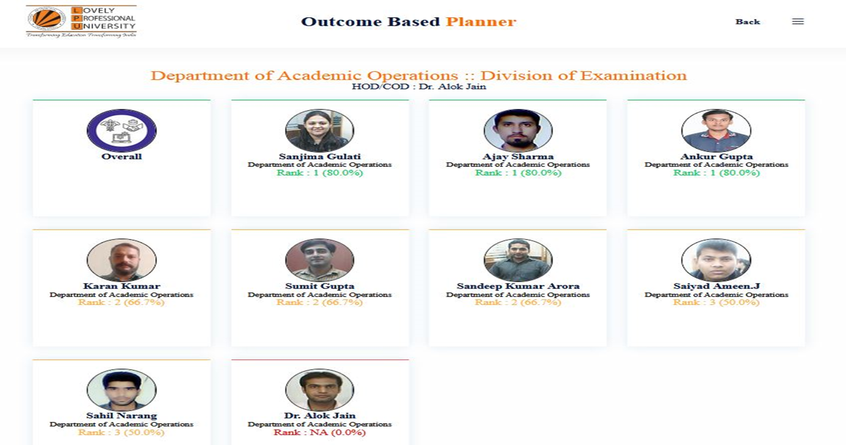
Outcome Planner Progress
Reason for less than 60%: One Planner point is yet to be deleted for which request has been sent already

Slide 52
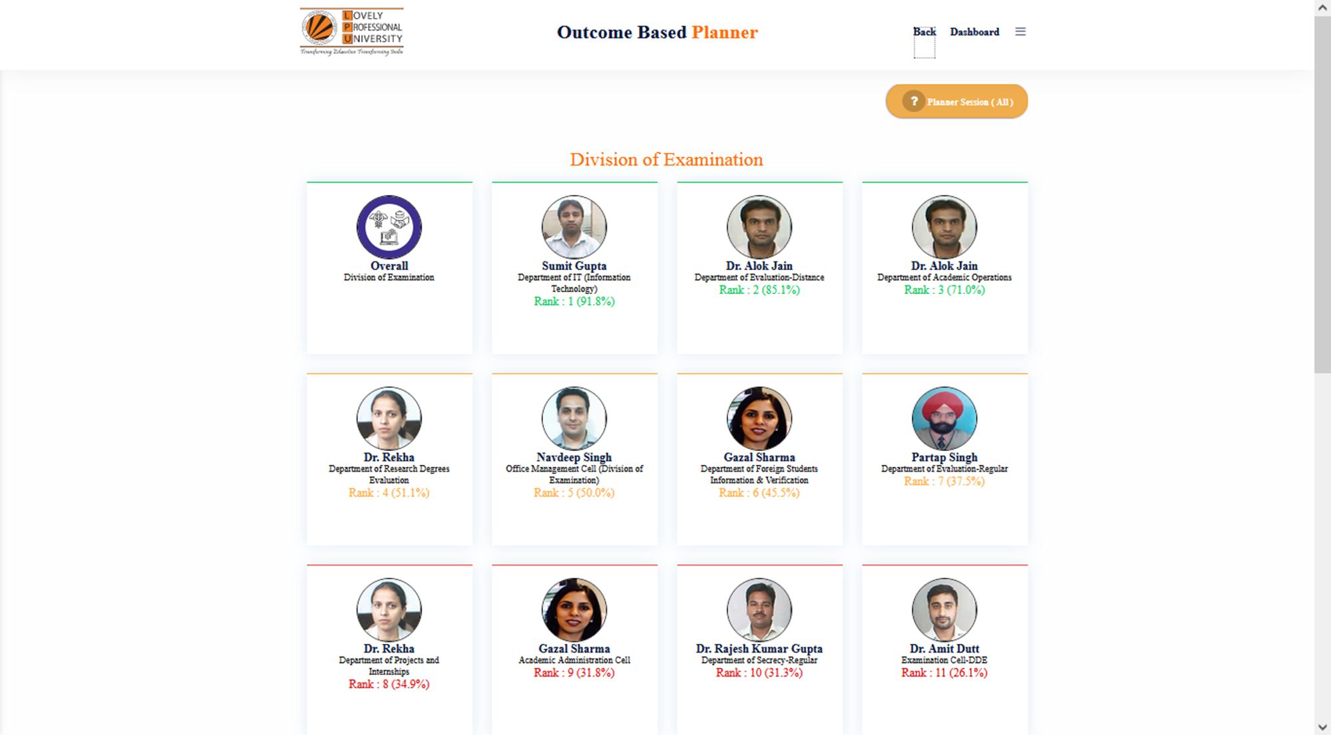

Slide 53


Issues of discussion
We have been working to automate the recurring tasks for which we are looking at new interfaces that were displayed earlier but most of them are under the development phase.
Things are moving very slowly in the development end as they are also packed with random and new tasks every now and then.
Academic operations Initiatives

Slide 54

Thank You

